Slide 1
Combined Union Committee
Report

Slide 2

Remove the threat of
95
Job losses
CUC Request
No. 1

Slide 3
Withdraw
IMPOSED
policies
Disciplinary Policy
Capability Policy
Investigation Policy
Avoidance of Redundancy Policy
Redeployment Policy
Grading Review Policy
Framework for Staff Working Overseas
CUC Request
No. 2

Slide 4
Withdraw
£80K
Post Advert
Director of International Office and Student Recruitment
Telephone:01189 359444
Location:GLASGOW
Salary:c. £80K + bonus
Contract type:Full time
Contract term:Permanent
Glasgow Caledonian University
Ideas with Impact
Director of International Office and Student Recruitment
c. £80K + bonus
CUC Request
No. 3

Slide 5
Joint Review Bodies
Executive
  Salaries
  Perks
  Bonuses
  Expenses
2005/6
  More than £70K
  13
  More than £100K
  Nil
2009/10
  More than £70K
  41
  More than £100k
  9
CUC Request
No. 4

Slide 6
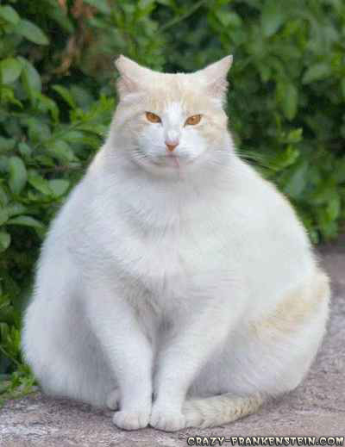
£70,000 - £79,999 17
£80,000 - £89,999 11
£90,000 - £99,999 4
£100,000 - £109,999 2
£110,000 - £119,999 3
£130,000 -£139,999 2
£140,000 - £149,999 1
£180,000 - £189,999 1

Slide 7
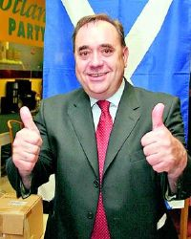
5 earn more than
Alex Salmond MSP
First Minister

Slide 8
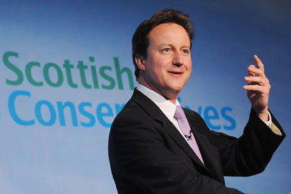
3 earn more than
David Cameron MP
Prime Minister

Slide 9
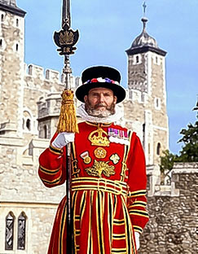
Joint Review Bodies
GCU London
£3million
60 students
Travel/Accommodation/Library/Furniture
CUC Request
No.4

Slide 10

Joint Review Bodies
Capital Expenditure
How much?
CUC Request
No. 4

Slide 11

Not being built……

Slide 12
Have to save ……..
“Recurrent Costs”

Slide 13
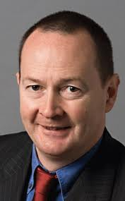
Support
Bill Kidd
Glasgow MSP
Executive Pay
  “Disgraceful”

Slide 14
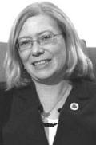
Support
Elaine Smith
Coatbridge MSP
GCU Alumni

Slide 15
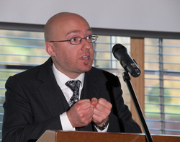
Support
Patrick Harvie
MSP for Glasgow
“Defend Public Services”

Slide 16
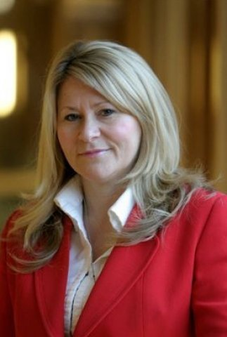
Support
Pauline McNeill
Local MSP for GCU.

Slide 17
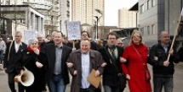
UNITY: Together we can win
http://caledonianunion.wordpress.com/

