Slide 1

Impact of Recession on Women
Emily Thomson
www.gcu.ac.uk/wise
Emily.Thomson@gcu.ac.uk
@wiseresearch
Notes:
Recession impacted on women –
As workers
As benefit claimants
As users of public services

Slide 2
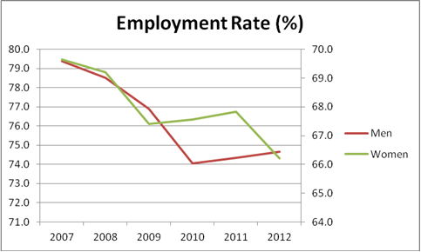
Women’s Employment in Scotland 2007-2012

Slide 3
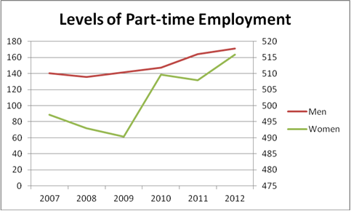
Part-time employment 2007-2012

Slide 4
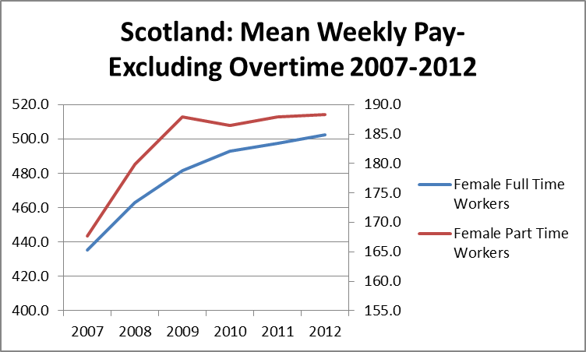
Women’s Weekly Pay 2007-2012

Slide 5
Graduate Gender Pay Gap 2012
20% of men are paid more than £30,000 after their degree, compared with just 8% of women
Law - 28% pay gap
Medicine - 9%
Education – 4%
(University of Warwick Institute for Employment Studies)

Slide 6
Welfare Reform
Child benefit freeze – 98% of those affected women
Tax credit cuts – 75%
Household benefit cap – 80%
Public sector pay employment contribution increases – 65%
To date, 74% of cuts taken from women’s income
74%!
Notes:
Cuts in maternity benefits, surestart centres,
31% of the funding to VAW services from local authorities was cut between 2010/11 to 2011/12.
Vital VAW services are taking a disproportionate hit of the 27% overall cut to local authority budgets.
Some are facing cuts of over 40%.

Slide 7
Outcomes of ‘recession’ and ‘austerity’
Impact of economic crisis and ‘austerity’ – women’s incomes and access to employment dramatically reduced
Services to protect victims of violence and sexual exploitation reduced
Increase in economic vulnerability of women and children, increasing their risk of exploitation
Notes:
Netmums survey -
mothers in low-income households are prepared to go without food, clothing and warmth in order to protect their children from the full impact of an inadequate income.
one in five mums are missing meals so their children can eat.

